Slide 1


SMART AGRICULTURE SYSTEM
By :Krish Shah

Slide 2
CONTENTS
What is IoT
Why IoT
IoT in agriculture
Applications
Methods Implemented
Advantages and Disadvantages
Conclusion

Slide 3
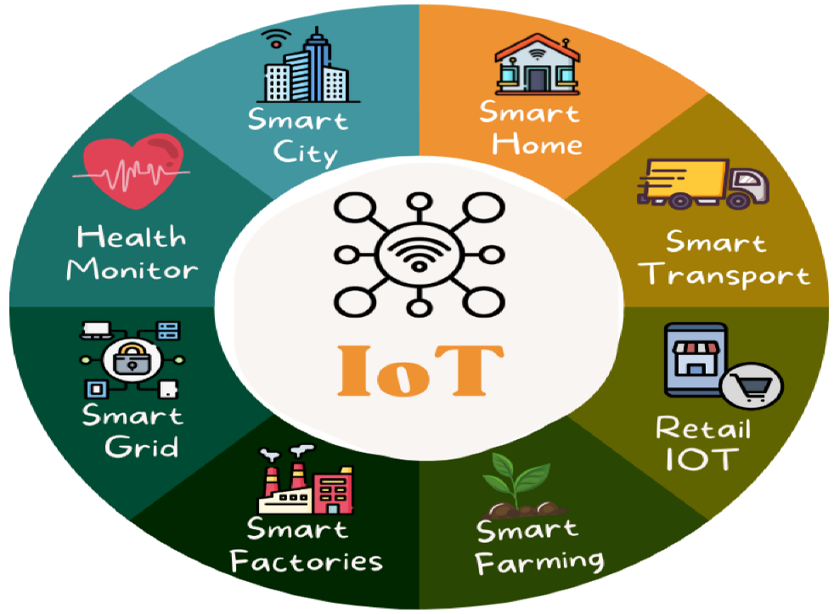
What is IoT?
IoT is short for Internet of things
The Internet of Things(IoT) is inter-networking of physical devices. This system has ability to transfer data over a network without requiring human-to-human or
human-to-computer interaction

Slide 4
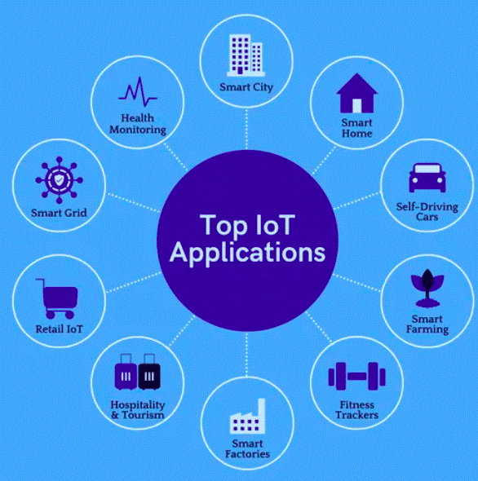
WHY IOT?
IoT has many applications in agriculture, smart cities, smart
home, healthcare etc.
This is a growing mega trend that will influence everything
from businesses to our daily personal lives.
Here we are mainly focused on agriculture as it plays a vital role in development of country’s economy.

Slide 5

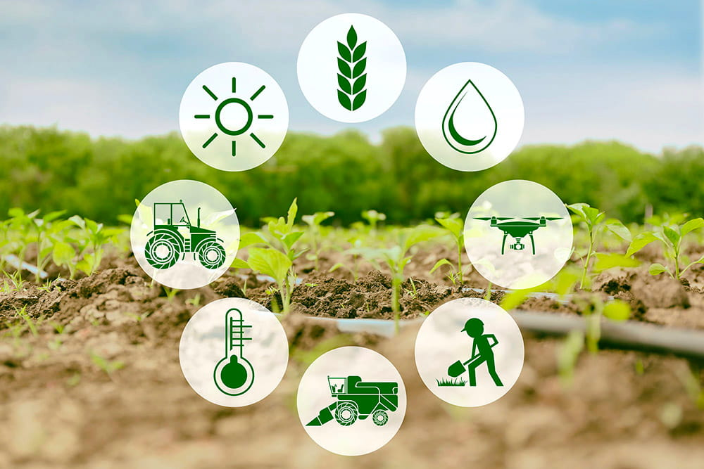
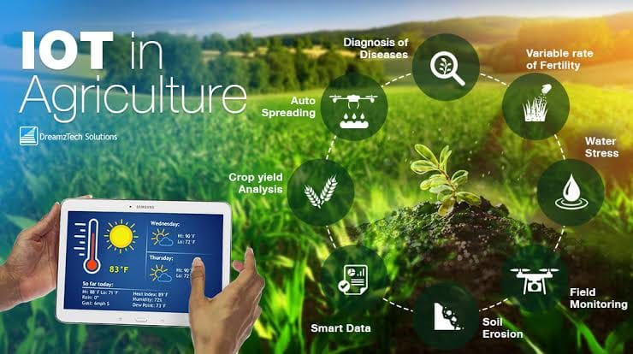
IoT in Agriculture
In Nepal, the economy is dominated by agriculture.
Around 55% of agricultural land is reported to be irrigated, yet year-round provision of water is often limited, making major crops like rice and wheat highly dependent on rainfall
Out of 2.7 million hectares of agricultural land in Nepal, only 1.3 Mha have irrigation facilities. The majority of irrigation systems are small and medium-scale

Slide 6
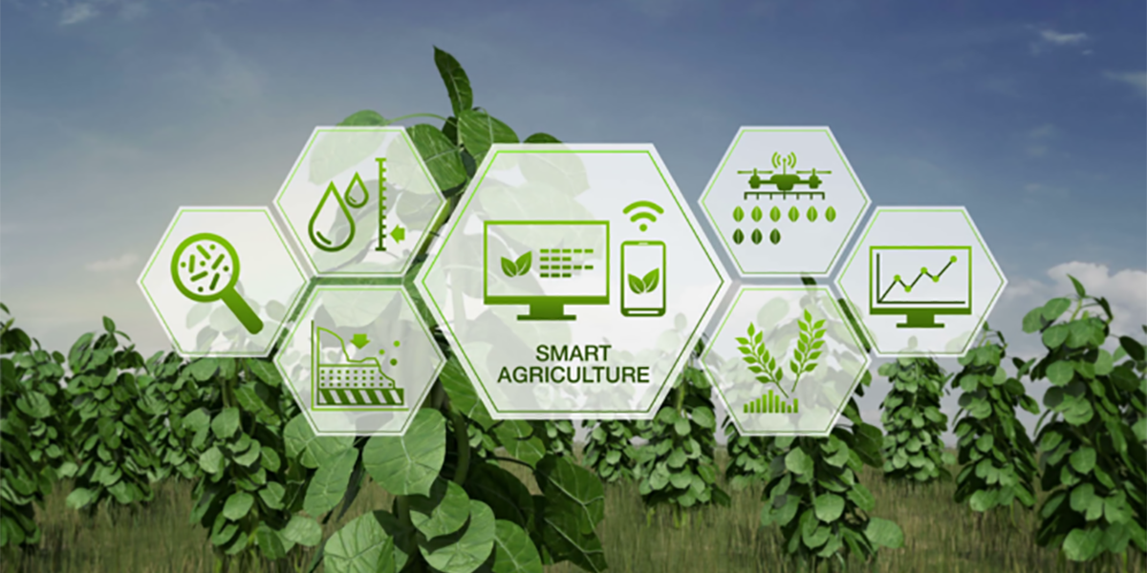
IoT application in agriculture
Crop water management
Precision Agriculture
Pest Management and Control Works

Slide 7
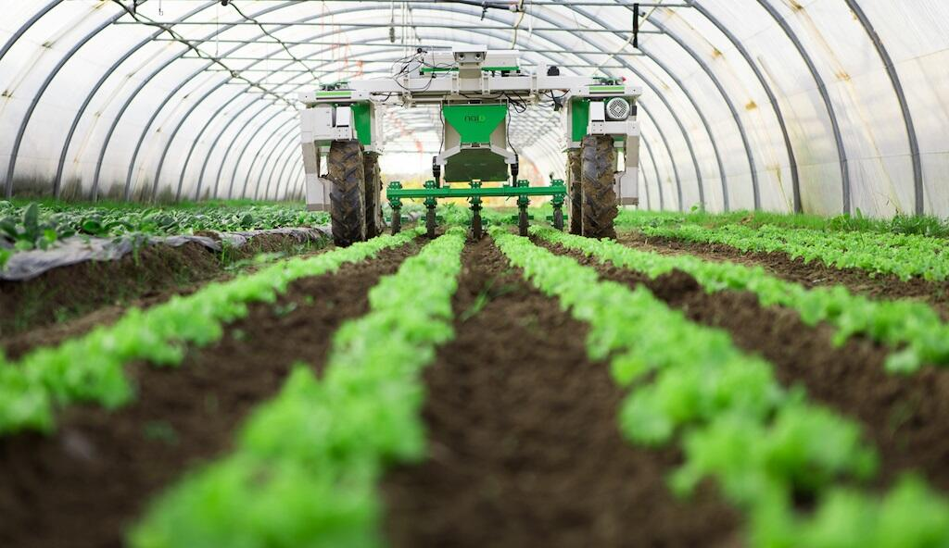
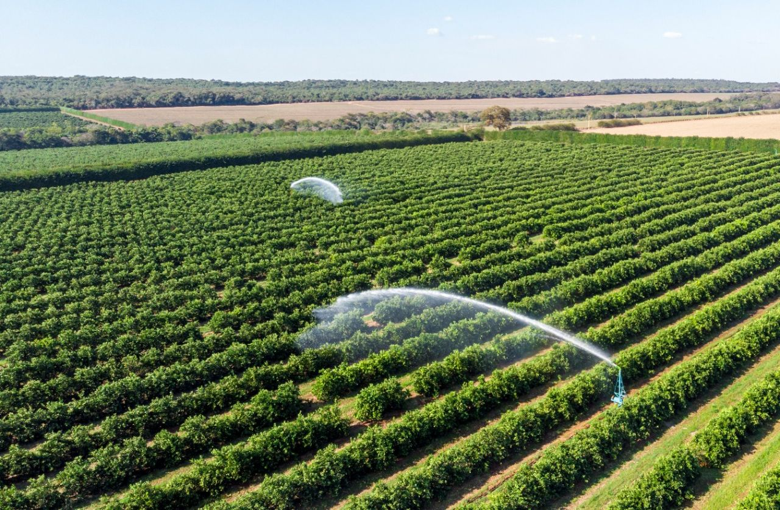
Crop Water Management
Usually the farmer pumps the water more or less to cultivate the land
This may result in wastage of water or insufficiency to the crops.
By using soil moisture sensor, farmer gets an alerting message when the moisture level increases or decreases

Slide 8
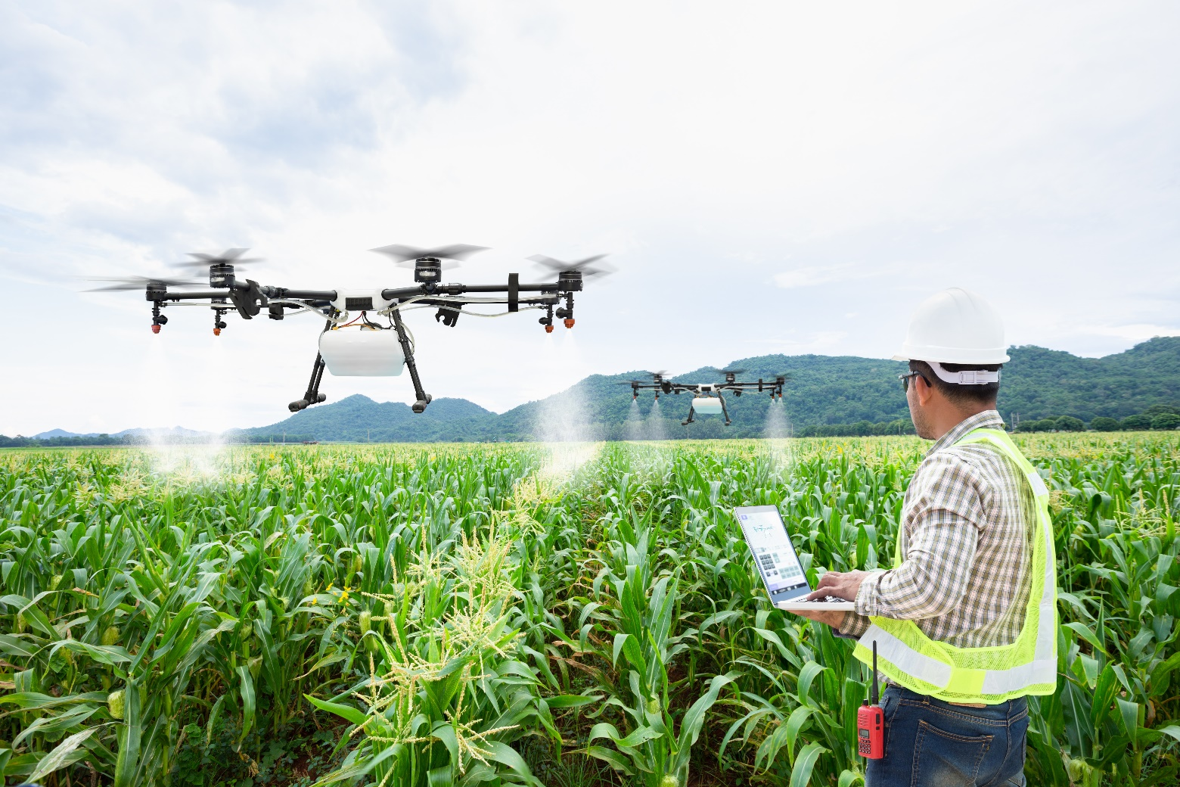
Precision Agriculture
Precision agriculture(PA) is a farm
management with IT, that ensures the
crops and soils to receive optimum health
and productivity.
PA is also known as satellite agriculture and SSCM(Site Specific Crop Management)
Sensors in fields measure moisture content and air satellite and robotic drones provide farmer with real time images

Slide 9
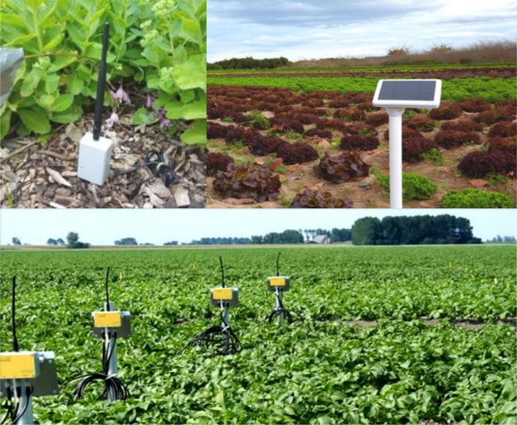
Pest Management And Control Works
Often farmers hard works are destroyed by pests that results in huge loss to farmers
To prevent such situation IoT has system that detects the motion of pest using PIR sensors.
This information can be used by the farmers to reduce damage done by predators

Slide 10
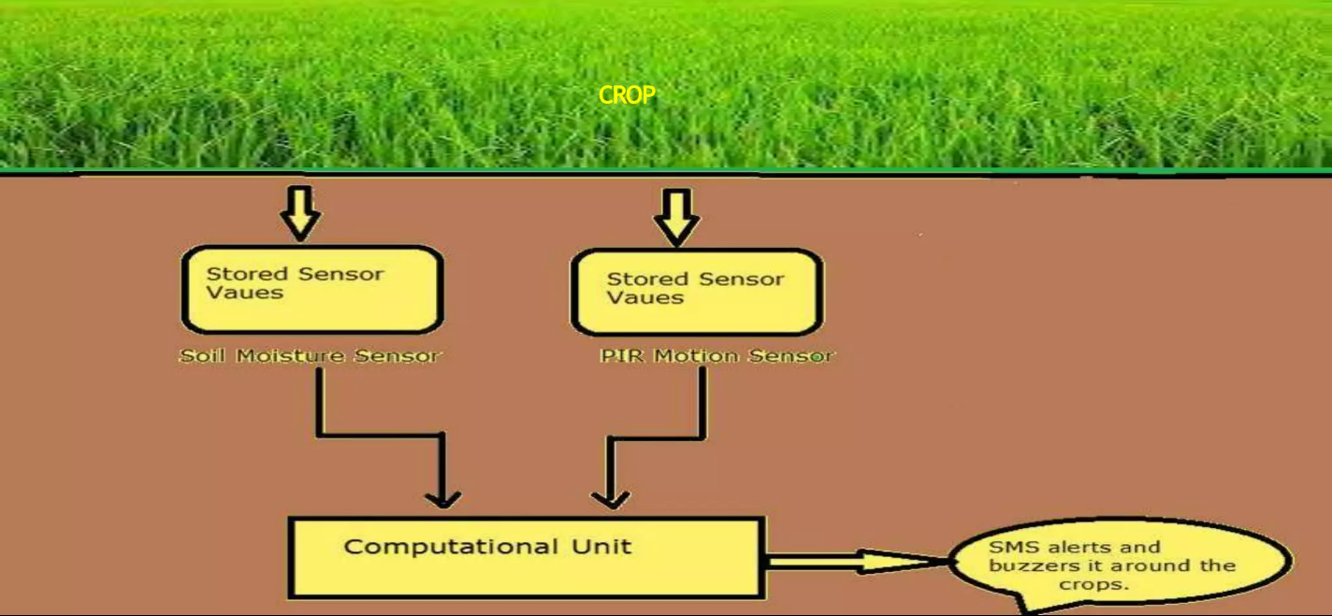
IMPLEMENTED METHOD

Slide 11
HARDWARE USED
Arduino Board
Soil moisture Sensor
Passive Infrared Sensor
LM35 Temperature Sensor

Slide 12


ARDUINO
Both SOIL MOISTURE SENSOR and PIR SENSOR are connected to the Arduino to perform an action
Arduino will send the data base using Ethernet shield and if emergency, it also sends message to the user by using a device called GSM module

Slide 13
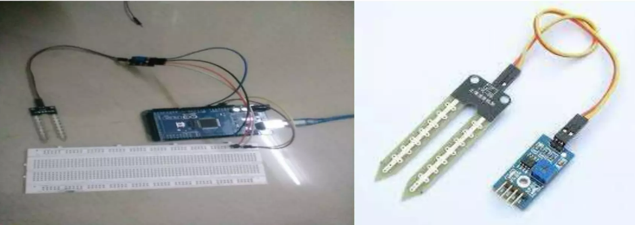
SOIL MOISTURE SENSOR
A sensor that will sense the moisture level in the land(sand) called SOIL MOISTURE SENSOR

Slide 14
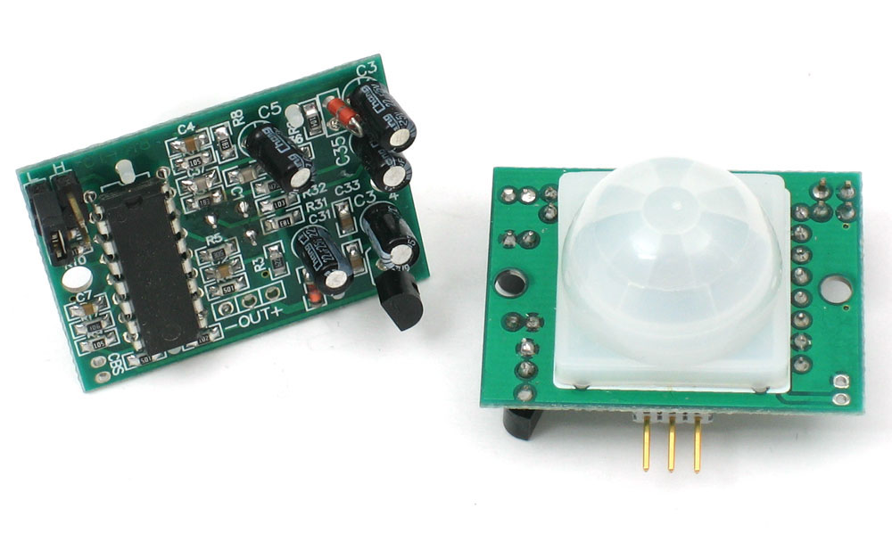
PASSIVE INFRARED SENSOR
A PIR based motion detector is used to sense movement of people ,animals or other objects.

Slide 15
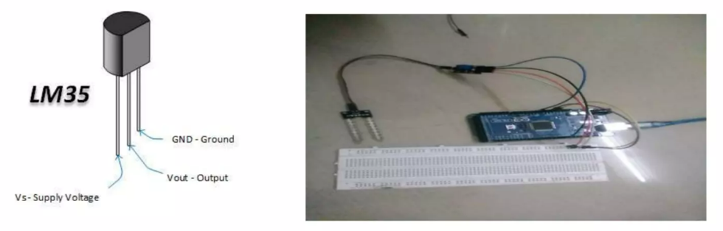
LM35 Temperature Sensor
The LM35 is one kind of commonly used temperature sensor that can be used to measure temperature with o/p comparative to the temperature (in °C).
It can measure temperature more correctly compare with a thermistor.
The LM35 has an output voltage that is proportional to the Celsius temperature. The scale factor is .01V/°C

Slide 16
ADVANTAGES & DISADVANTAGES
Advantages
Disadvantages
Cost effective method
Optimize water use
Sustain high-yielding
High quality crop production
Need for each soil type is calibrated

Slide 17
CONCLUSION
We can predict soil moisture level and motion of predators.
Irrigation system can be monitored
Damage caused by pests is reduced
Increased productivity
Water conservation
Profit to farmers

Slide 19
REFERENCES GOOGLE
https://ieeexplore.ieee.org/document/8538702
https://vikaspedia.in/agriculture/ict-applications-in-agriculture/iot-in-agriculture

Slide 20
Thank you

